Slide 1


Social Buzz

Slide 2


Today's agenda
Project recap
Problem
The Analytics team
Process
Insights
Summary

Slide 3

Social Buzz is a global unicorn technology company growing at an accelerated rate. Accenture has embarked in a 3 month work pilot to help tackle their biggest challenges which include:
Audit of Social Buzz Big data practice
Implementation of an IPO
Analysis of top 5 popular categories content
Project Recap

Slide 4


Problem
Social Buzz has reached over 100,000 posts per day which take us to 36,500,000 pieces of content per year!
But how do we capitalize on it when there is so much?

Slide 5



Andrew Fleming
Chef Technical Architect
The Analytics team
Marcus Rompton
Senior Data Expert
Uday Mayank Dhodi
Data Analyst

Slide 6
Process
1
Understanding problem
Data Extraction
2
3
Data Cleaning
4
Data Analysis
Data Visualization to uncover insights
5

Slide 7

Insights
16
1969
January
Unique Category
Reactions to"animals"
Month with highest posts

Slide 8
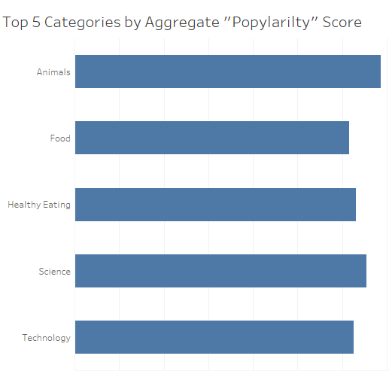
The top 5 most popular categories of content were animals, science, healthy eating, technology, and food. Animals had an aggregate popularity score of 74,965.
It's fascinating to see both animals and science within the top 5, this shows that people like seeing real-life content the most. No wonder healthy eating made it to the top 5 as many people are very keen when it comes to making healthy choices.

Slide 9
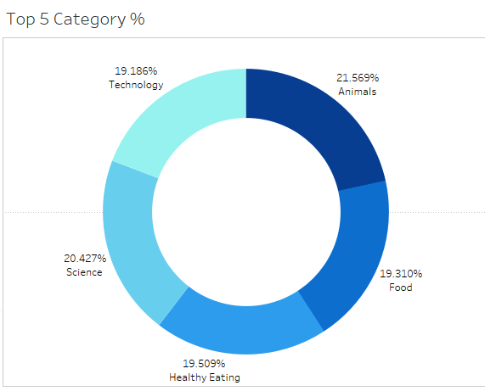
We can see that there isn't a big difference from the chart split between popularity of the top 5 categories. The first largest percentage animals outperformed the second largest one science by 1.1%.

Slide 10

Animals and science were two of the most popular content categories with healthy eating ranking as the third one. We recommend creating more content related to those categories to boost user engagements.
Healthy eating can be placed in the same category as "food". We suggest collaborating with healthy food brands to help bring brand awareness and to reach wider audience.
With this technology age, there is no surprise to see technology in top 5 categories. It shows that users enjoy tech contents. Collaborating through brands partnership with tech companies will definitely increase engagement rates.
Summary

Slide 11

Thank you!
ANY QUESTIONS?

